Slide 1
CIDM 6312 – Seminar in Data Visualization.
HW3
Submitted By: Tiwalope Shadare

Slide 2
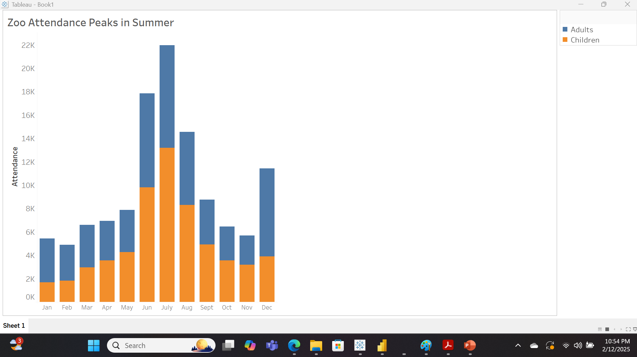
Categorical Colors – Stacked Column Chart Depicting Zoo Attendance by TS.

Slide 3
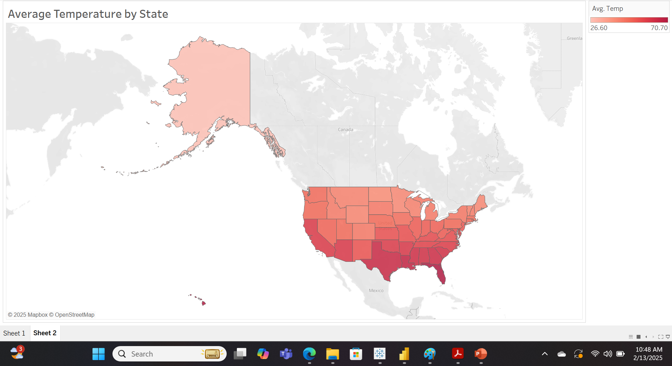
Choropleth Map in Sequential Color – Displaying Average Temperature across the US by TS.

Slide 4
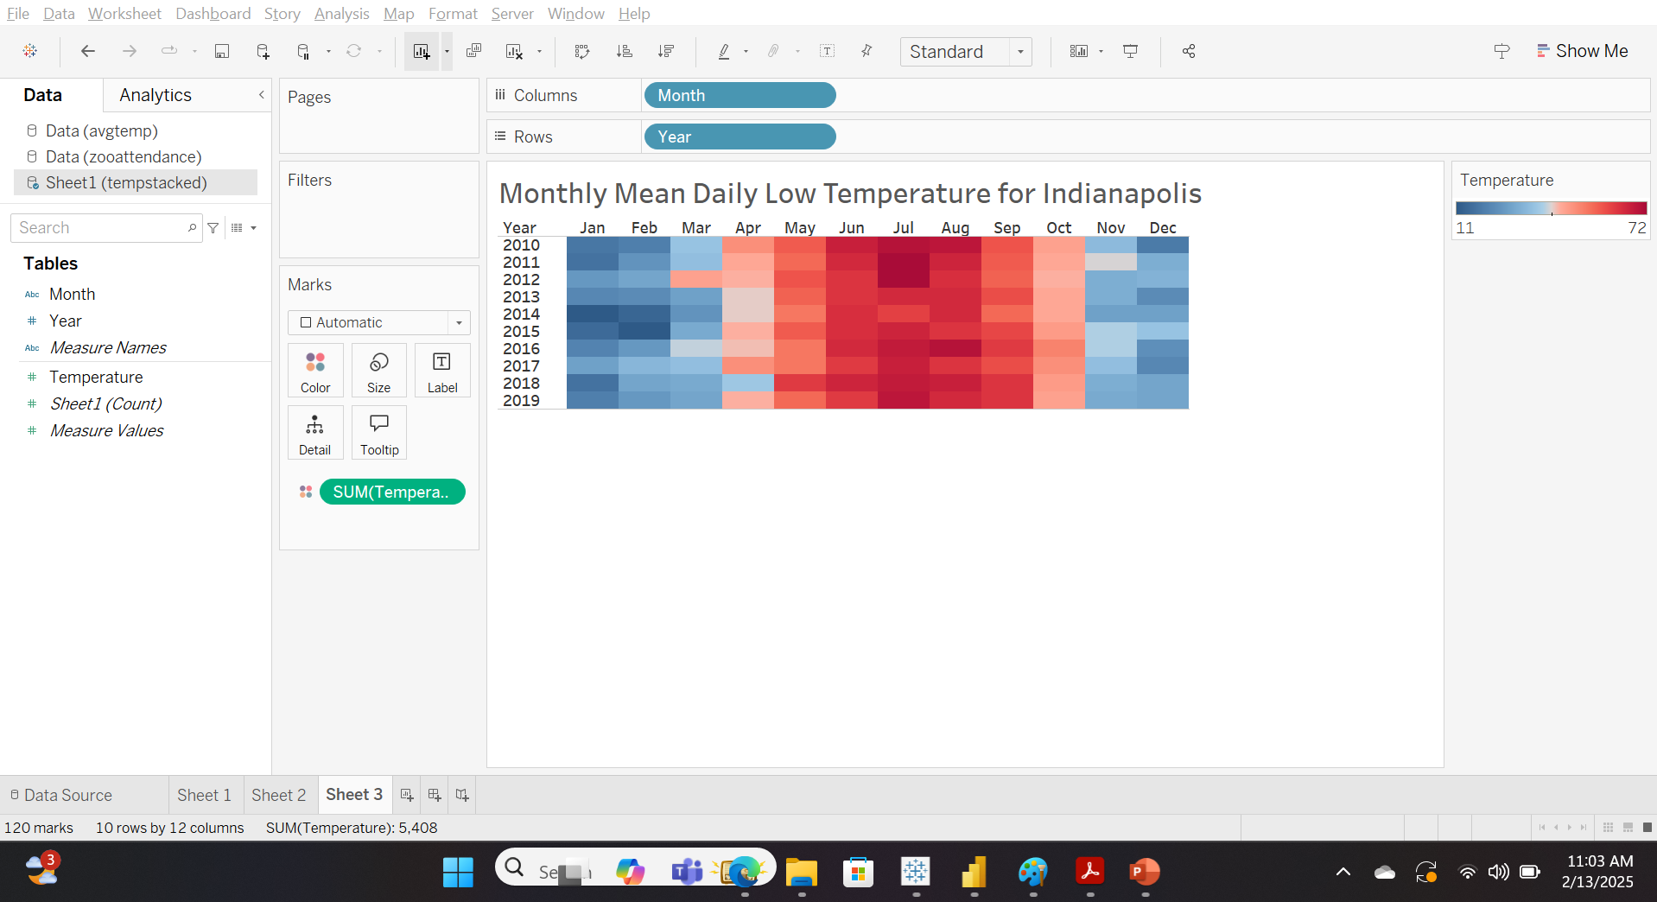
Diverging Colors – Heat Map Illustrating Average Temperature for Indianapolis by TS.

Slide 5
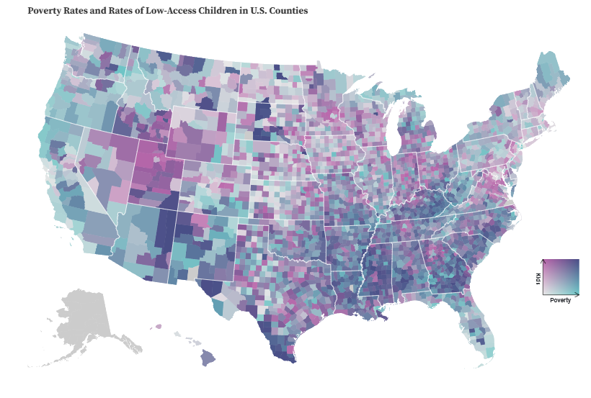
Part 2 – Choropleth Map of poverty rate and percentage of “low access” kids in the US
Goal: Choropleth map showing the poverty rate and percentage of “low access” kids across the US.
Chart type: Choropleth Map.
Hyperlink: Bivariate Choropleth with Continuous Color Scales and Tooltips for US Food Access Data / Kelly Ervin Mills | Observable.

Slide 6
Part 2: Choropleth Map - Analysis and Critiques
Attributes of color: Saturation.
Color Scheme: Sequential color scheme
Custom Color using the HSL Color System: Multiple colors were used in this chart; it is difficult to provide the HSL color system used.
Common Mistakes in the Use of Color: The main error in this choropleth map is the excessive use of color. Typically, a choropleth map employs a sequential gradient of a single hue. This map attempts to represent multiple rates (poverty and the percentage of low-access children) by using purple for the percentage of low-access children and blue for the poverty rate. Consequently, the map becomes challenging to comprehend and interpret effectively.

Slide 7
Part 2: Choropleth map - Proposed Corrections
Here are some recommendations to enhance the map:
Create separate Choropleth maps: Develop two individual maps—one for the poverty rate and another for the percentage of low access children. Utilizing a distinct sequential color for each map will improve readability.
Utilize state averages and consistent color gradients: Construct the maps based on the average values for each state and apply a single color gradient per state. Given that the data encompasses the entire United States, this approach will facilitate a clearer comparison of poverty rates between states.
Include a comprehensive legend: Incorporate a legend indicating the maximum and minimum rates. This addition will enable the audience to accurately interpret the rate in relation to the color gradient applied to each state or section of the map being analyzed.

Slide 8
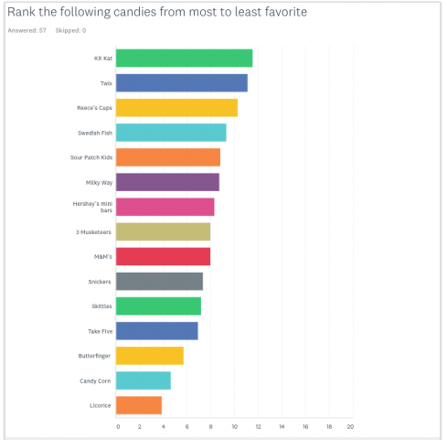
Part 2 – Bar Chart of Students’ favorite candies
Goal: Bar chart showing students’ favorite Halloween candies
Chart type: Bar Chart
Hyperlink: Kit Kat Win in HHS Broadcaster Survey of Students’ Favorite Halloween Candies – The Broadcaster

Slide 9
Part 2: Bar Chart – Analysis and Critiques.
Attributes of color: Hue
Color Scheme: Categorical color scheme
Custom Color using the HSL Color System: Multiple colors were used in this chart; it is difficult to provide the HSL color system used.
Common Mistakes in the Use of Color: The primary issue with this chart is the unnecessary use of colors. Employing a single color for all the bars would enhance clarity. The current use of multiple colors is distracting and lacks consistency, as there are several bars per color with no apparent commonality. This may lead the audience to inadvertently attempt to group the colors, detracting from the overall message of the chart and increasing cognitive load.

Slide 10
Part 2: Bar Chart – Proposed Correction
Below is my suggested revision for the bar chart:
Utilize a single color for the bars representing the various candies in the bar chart. As indicated by the textbook, color should be utilized only when it conveys information that no other aspect of the chart can communicate to the audience. The use of multiple colors in this context is unnecessary and does not contribute to the message being conveyed. The length of the bars alone suffices to effectively communicate the intended message; therefore, all bars should be uniform in color.

Slide 11
Part 3 - Reflection
Summary of Key Learnings
Chapter 4 highlights the strategic use of color in charts and maps to improve communication, evoke emotions, and enhance readability. Key concepts include:
Attributes of Color: This encompasses Hue, Saturation, and Luminance. The three primary hues are frequently combined to generate other hues known as secondary hues, which can subsequently be combined to produce tertiary hues. Saturation refers to the intensity or purity of a color, while luminance refers to the degree of whiteness or blackness of a color, indicating its brightness.
Color psychology and symbolism: involve studying the relationship between colors and human behavior. Understanding this can help determine when to use warm or cool hues depending on the audience and the message being conveyed. Color symbolism refers to the cultural meanings of color for certain demographics. This is an important factor to consider when creating charts to account for the audience's perspective.
Color Schemes: Include categorical, sequential, and diverging color schemes. These color schemes are used in visualization charts. Categorical color schemes are used in bar and column charts, sequential color schemes are used in choropleth maps to show gradient representation of a range of values, while diverging color schemes are used for heat maps to show the combination of two sequential colors with a shared end point.
Creating Custom Colors with the HSL Color System: We examined the methodology of generating custom colors by manipulating Hue, Saturation, and Luminance gradients to achieve desired color variations.
Common mistakes in the use of color: The application of color in visualization charts can often be misapplied. Frequent errors include, but are not limited to, the unnecessary use of color, excessive use of color, insufficient contrast, and failure to consider color blindness, among other issues.

Slide 12
Part 3 - Reflection
Application of Concepts
The chapter on the use of color has been highly informative. While many of the concepts discussed were familiar to me, several were particularly insightful. The following are some of the concepts I intend to apply in the future:
Considering color-blindness when creating charts like heat maps. At work, we ensure that every application or visualization is accessible to everyone, including those with vision impairment, by using large fonts and maintaining sufficient contrast in our charts. However, we currently use default settings for our heat maps and conditional formatting without considering accessibility for color-blind audiences. Moving forward, this will be considered.
Color Symbolism: At my workplace, our audience is not only local to the United States but also includes individuals from diverse regions across the globe. When designing charts and visualization tools, I will carefully consider the cultural significance of colors in various countries before selecting them for my visualizations. Taking color symbolism into account will help ensure that no one is inadvertently offended and that our intended message is accurately communicated.

